Slide 1
Java EE Concepts
Avaloq Innovation Ltd
November 2016
Simon Nattrass
Avaloq Evolution AG | Allmendstrasse 140 | 8027 Zurich | Switzerland
T +41 58 316 10 10 | F +41 58 316 10 19 | www.avaloq.com

Slide 2
Agenda
Why?
Limitations and Expectations
What is Java Enterprise Edition (Java EE)?
Context and Dependency Injection (CDI)
Java Persistence Architecture (JPA)
Enterprise Java Beans (EJB)
Java Message Service (JMS)
Interfaces – WebServices (JAX-WS)
Interfaces – REST (JAX-RS)
Packaging

Slide 3
Why?
To work with many of our code bases a grounding in JavaEE concepts is a prerequisite.
The manner in which we use the platform is not always clear enough to be leveraged as an example.
The core concepts are relatively static, while our patterns, by comparison are constantly evolving.

Slide 4
Expectations
This is a whistle-stop introduction to JavaEE concepts, with the aim to reduce the ramp-up for becoming with familiar with JavaEE based code at Avaloq.
It is no way comprehensive and omits much.
Considerable personal effort will still be required, but you will have now have some idea of where to look for answers.
Familiarity with Java is a pre-requisite.
Tools (IDEs, build tool JBoss etc…), design and Avaloq specific patterns may be mentioned in passing but are not explicitly covered.

Slide 5

“It is no way comprehensive and omits much”

Slide 6
Huh?
What is Java Enterprise Edition (JavaEE)?

Slide 7
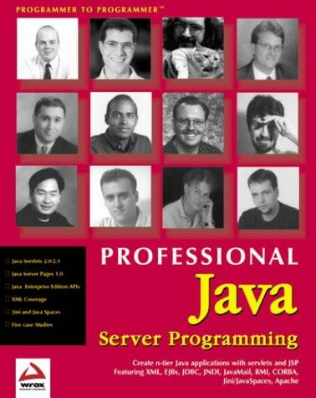
Groan

Slide 8
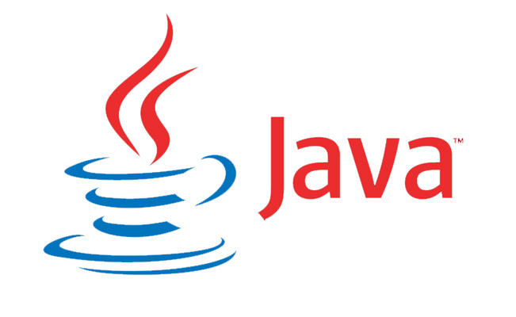
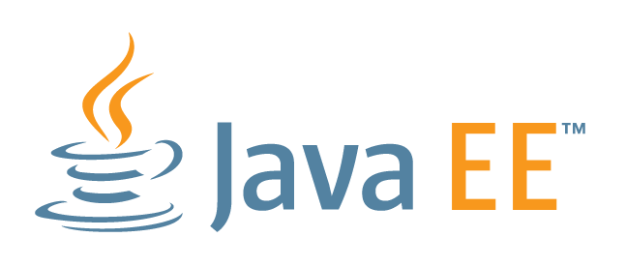
JavaSE & JavaEE

Slide 9

Don’t nod off!

Slide 10
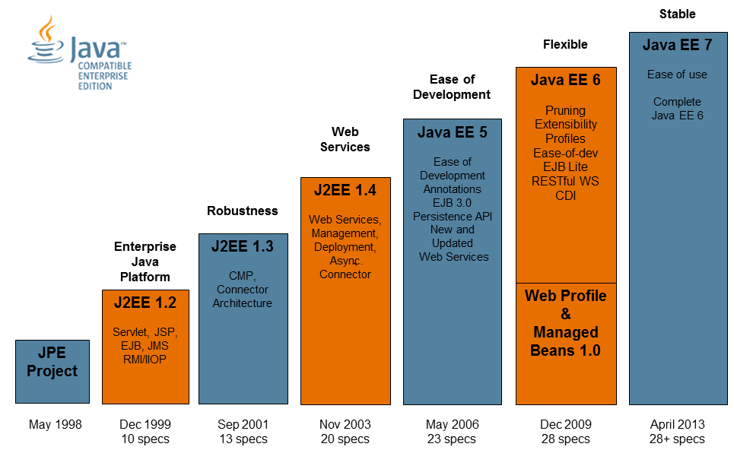
Java EE History

Slide 11
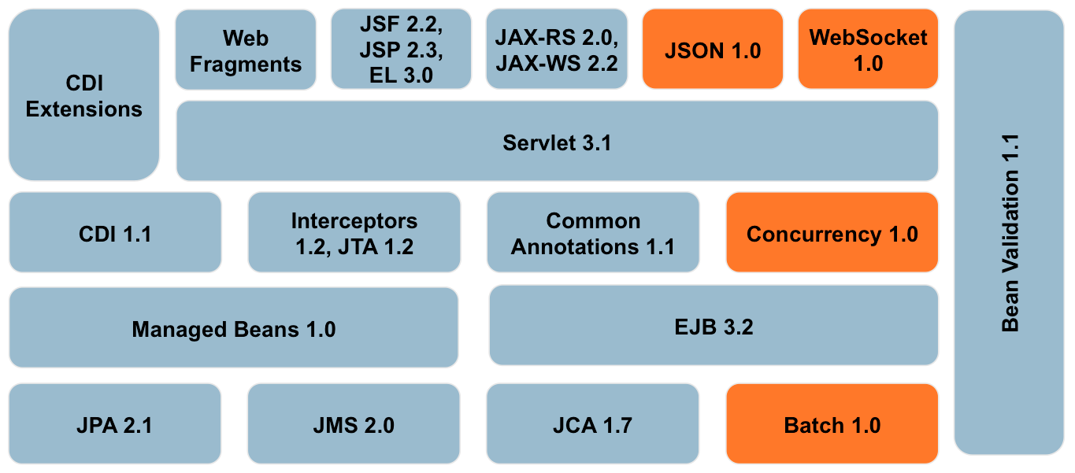
Java EE Specs

Slide 12
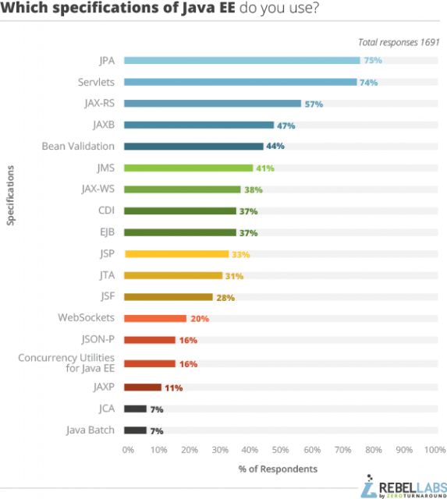
Spec Popularity

Slide 13

Enterprise Toolbox

Slide 14
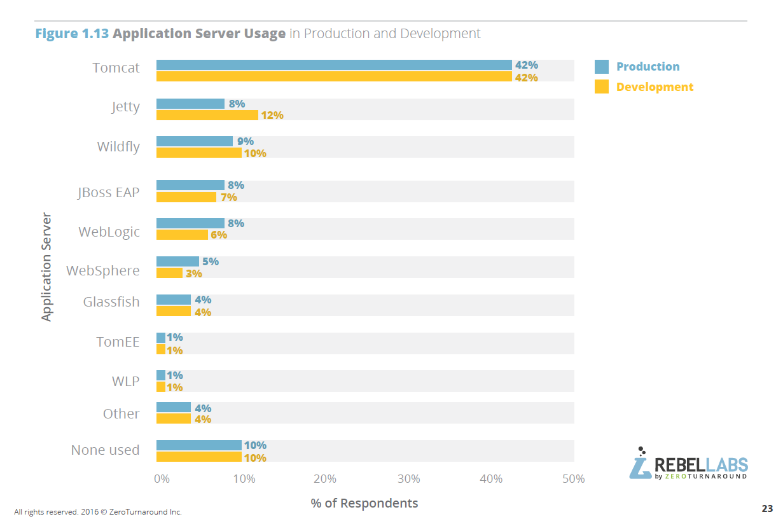
Java “Application Server” / Java EE Server / The Container

Slide 15
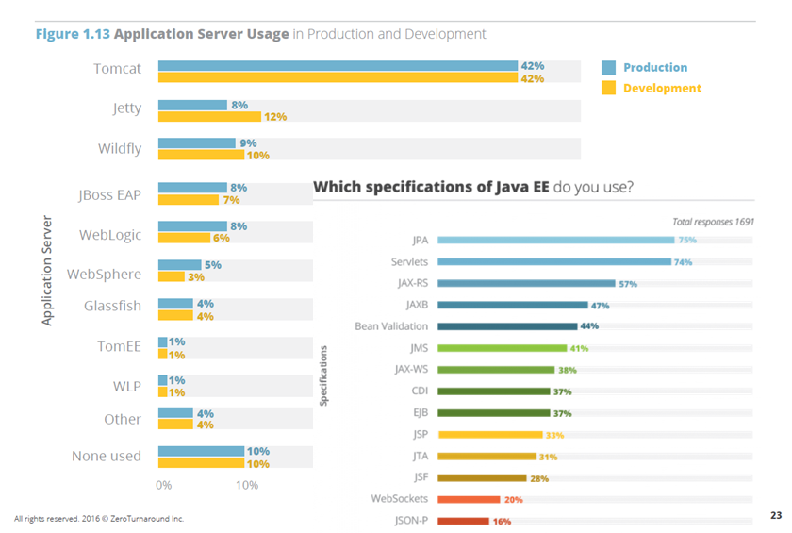
Java “Application Server” / Java EE Server / The Container

Slide 16
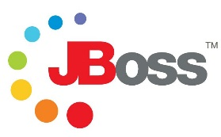

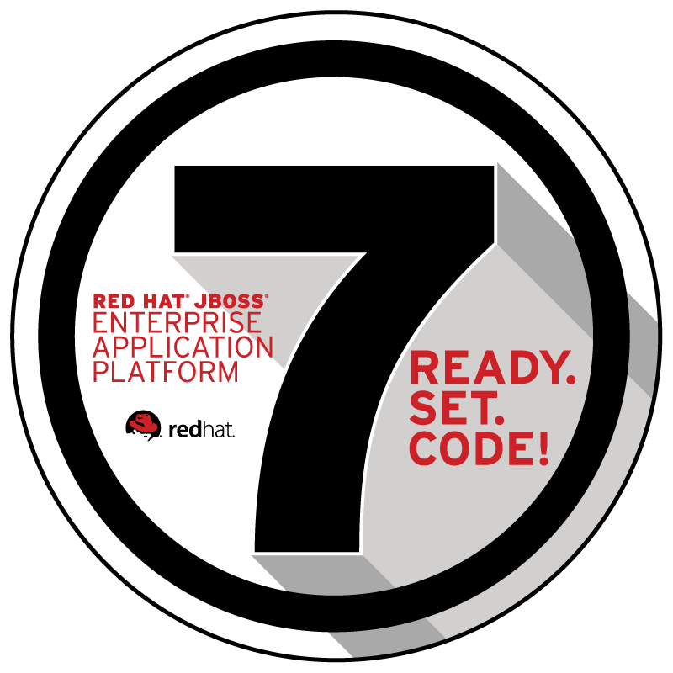
JBoss and WildFly

Slide 17
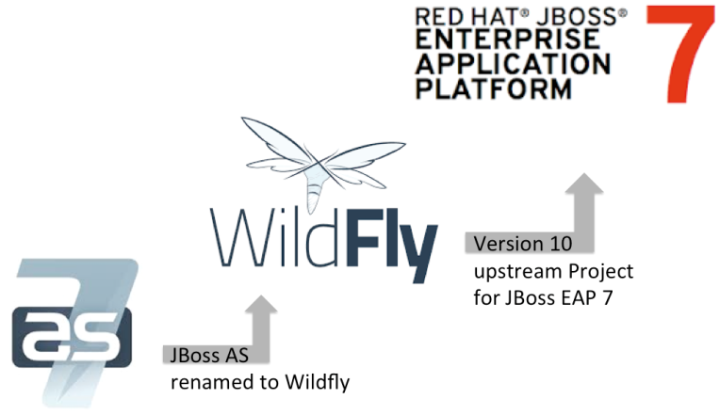
JBoss and WildFly

Slide 18
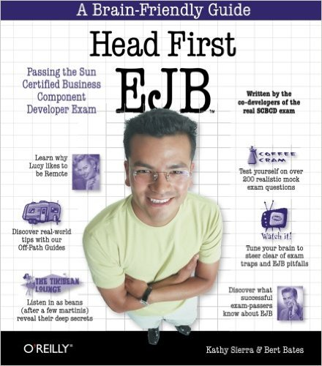
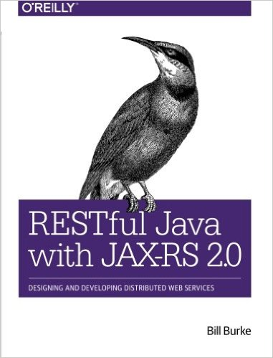
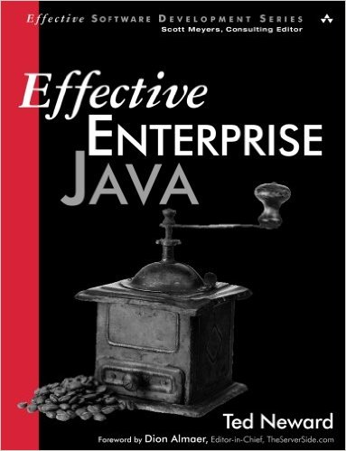
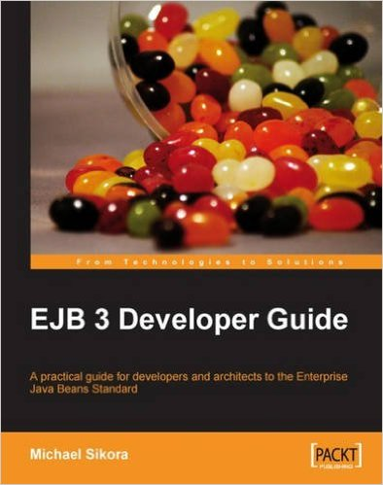
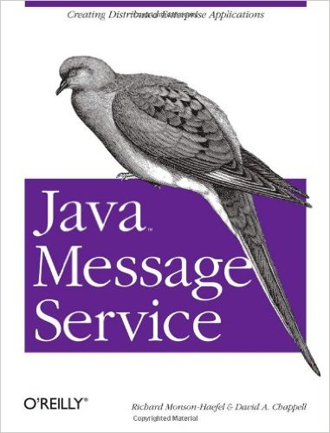

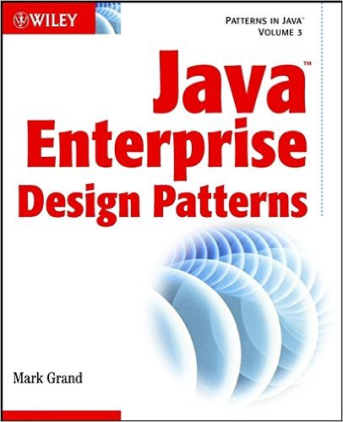
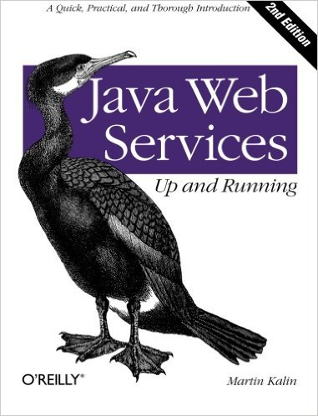
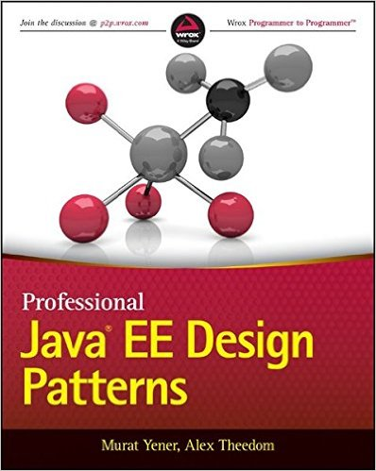
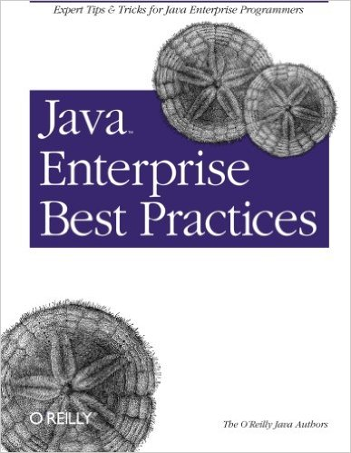
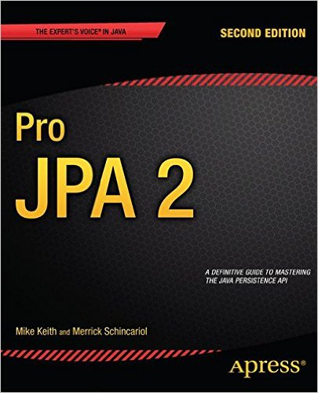
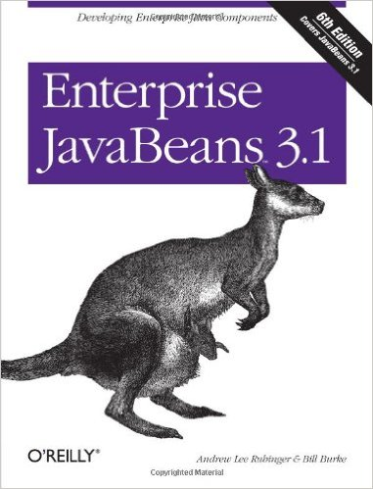
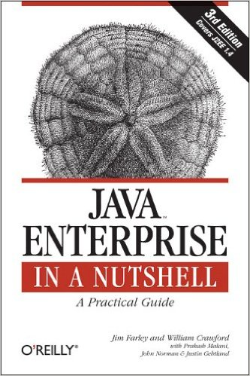
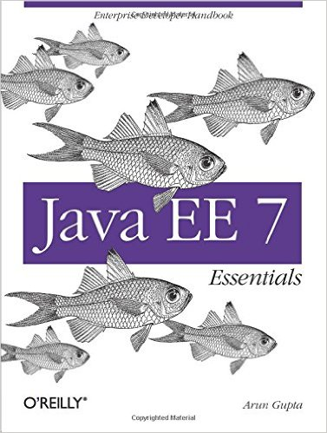
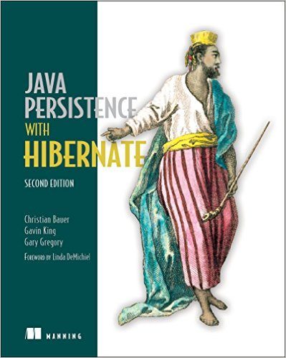
Agenda

Slide 19





Not the only kid on the block

Slide 20
Ready?
The Plan

Slide 21
Contents
The wiring… Context and Dependency Injection (CDI)
Working with the database… Java Persistence Architecture (JPA)
Your business logic… Enterprise Java Beans (EJB)
Reliable messaging… Java Message Service (JMS)
Interfacing (old school) … Web Service / SOAP (JAX-WS)
Interfacing (new school) … REST (JAX-RS)
Packaging

Slide 22

The wiring…
Context and Dependency Injection (CDI)

Slide 23
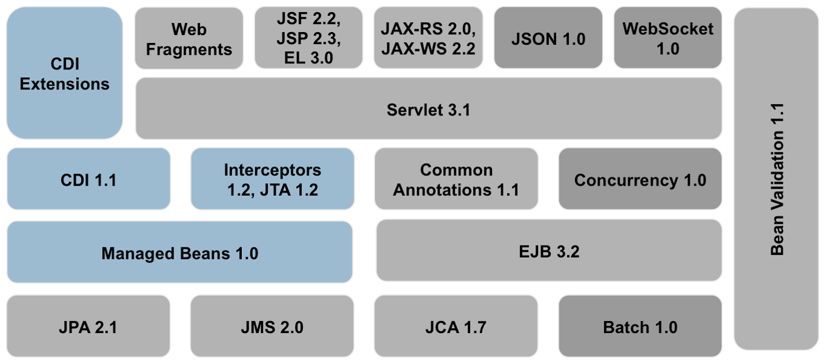
Context and Dependency Injection – Big Picture
Intro.

Slide 24
Context and Dependency Injection
Java Beans
Inversion of Control
Injection points
Ambiguity / Qualifiers
Producers
Interceptors
Lifecycle
Scopes / Contexts

Slide 25
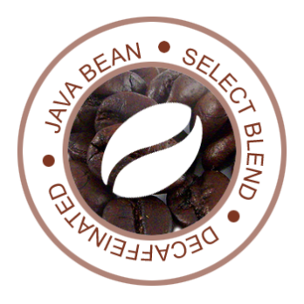
Java Bean
Java Bean is a standard:
Private properties.
Getters / Setters.
No-arg constructor.
Implements Serializable.
Basically POJOs.
Beans which are managed by a container are known as Managed Beans.
CDI Managed Beans
Enterprise Java Beans

Slide 26
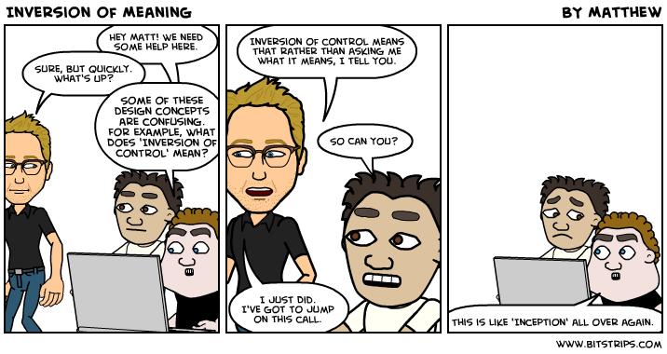
Inversion of Control

Slide 27


Inversion of Control (IoC)
A design principle where dependencies within a program are provided to it by a external framework.
This is an inversion of traditional procedural programming which is responsible for the lifecycle of these dependencies.
IoC promotes loosely coupled software and separation of concerns.
Popularized my Robert Martin and Marin Fowler.
.

Slide 28
Injections Points
Inversion of control, separation of concerns.
You can @Inject a bean at a field, method or constructor.
SOLID.
DI provided by the container.
public interface Greeting {
String greet(String name);
}
public class EnglishGreeting implements Greeting {
public String greet (String name) {
return "Hello " + name;
}
}

Slide 29
Manual creation – new()
public class GreetingService {
private Greeting greeting = new SimpleGreeting();
public String greet(String name) {
return greeting.greet(name);
}
}
The GreetingService is responsible for the creation of the Greeting concretion.
Poor separation of concerns.
Extra burden.
How to test? (tight coupling).

Slide 30
DI via @Inject
public class GreetingService {
@Inject
private Greeting greeting;
public String greet(String name) {
return greeting.greet(name);
}
}
The CDI framework is responsible for the injection of the Greeting concretion.
Can vary the concretion at run time.
Better separation of concerns.
Better for testing.

Slide 31
Ambiguous
public interface Greeting {
String greet(String name);
}
public class EnglishGreeting implements Greeting {
public String greet (String name) {
return "Hello " + name;
}
}
public class DeutschGreeting implements Greeting {
public String greet (String name) {
return "Hallo " + name;
}
}
The CDI framework is responsible for the injection of the Greeting concretion.
Can vary the concretion at run time.
Better separation of concerns.

Slide 32
DI via @Inject
public class GreetingService {
@Inject
private Greeting greeting; // which Greeting?
public String greet(String name) {
return greeting.greet(name);
}
}
Which implementation is injected at runtime now?

Slide 33
Qualifiers
@Deutsch
public class DeutschGreeting implements Greeting {
public String greet (String name) {
return "Hallo " + name;
}
}
public class GreetingService {
@Inject @Deutsche
private Greeting greeting; // ah, the German one!
public String greet(String name) {
return greeting.greet(name);
}
}

Slide 34
Producers
@Ibject and @Qualifer provide static bean injection.
Producers provide runtime injection.
Object injected may not even be a bean a may require custom initialization.
Similar to factory pattern.
@Produces @StereotypicalName
public Name nameProvider () {
//...
}
@Inject @StereotypicalName
private Name name;

Slide 35
Interceptors
Aspect Orientated Programming (AOP).
Useful for cross-cutting concerns.
Additional behavior is added to existing code without modifying the code itself.
This allows behaviors which are not central (i.e. separate concerns) to be added without cluttering the code.

Slide 36
A Before and After Logging Interceptor
@AroundInvoke
public Object applyLog(InvocationContext context) throws Exception {
String methodName = context.getMethod().getName();
System.out.println("Before calling method " + methodName);
Object response = context.proceed();
System.out.println("After calling method " + methodName);
return response;
}

Slide 37
LoggingInterceptor
@Inject
private Greeting greeting;
@Interceptors(LoggingInterceptor.class)
public String greet(String name) {
return greeting.greet(name);
}

Slide 38
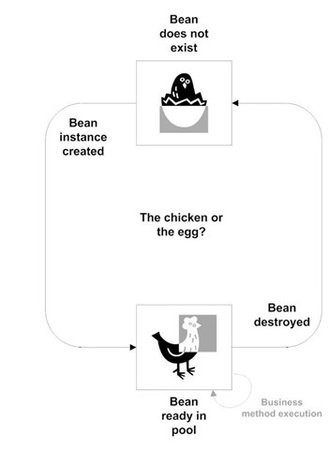
Bean Lifecycle
public class ABC {
// no state here
public ABC() { // ctor }
@PostConstruct
public void init() { // ... }
@PreDestroy
public void cleanup() { // ... }
}

Slide 39
Scopes and Contexts
@RequestScoped
Bean is scoped to the request and is destroyed once the request is complete.
@ApplicationScoped
Bean is scoped to the application. The bean is created when the application is started, holds state throughout the application and destroyed when the application shuts down.
@Dependent
This is the default scope if none is provided. The bean takes the scope of the creating bean.
@SessionScoped
@ConversationScoped

Slide 40
beans.xml
Beans are deployed in bean archives which have discovery modes:
All, annotated (default) none.
<beans xmlns="http://xmlns.jcp.org/xml/ns/javaee"
xmlns:xsi="http://www.w3.org/2001/XMLSchema-instance"
xsi:schemaLocation="http://xmlns.jcp.org/xml/ns/javaee
http://xmlns.jcp.org/xml/ns/javaee/beans_1_1.xsd"
version="1.1" bean-discovery-mode="all">
</beans>
.
Must either be in
(wars) WEB-INF or WEB-INF/classes/META-INF
(jars) META-INF

Slide 41
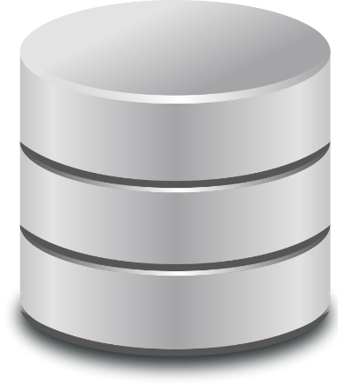
Working with the database
Java Persistence Architecture (JPA)

Slide 42
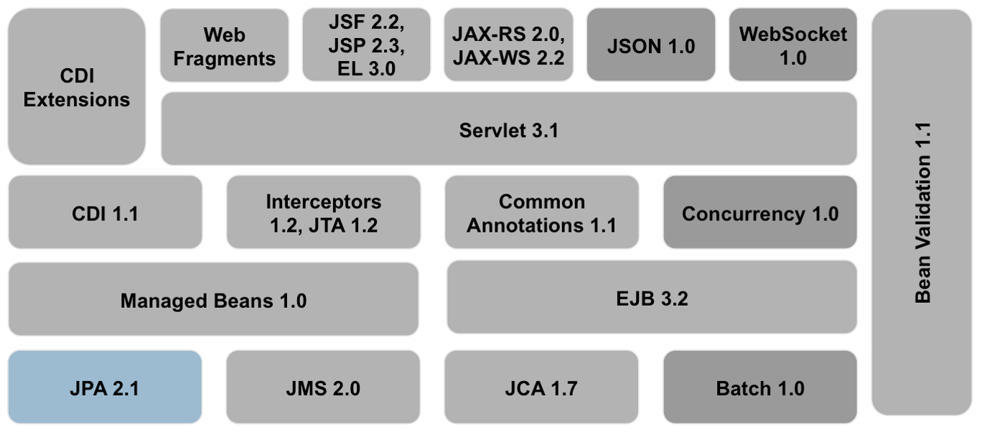
Java Persistence Architecture – Big Picture
Intro.

Slide 43

Java Persistent Architecture (JPA)
Intro
ORM
Entities
Persistence Unit, Persistence Context Entity Manager
Hibernate Session

Slide 44
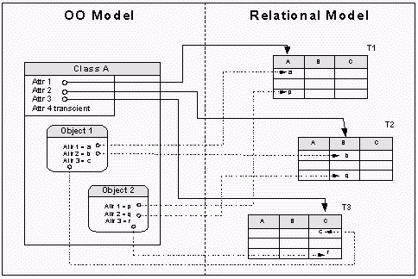
Object Relational Mapping
Used to map between RDBMs and OO.
Abstracts away from relational model.
Database independency.

Slide 45
Entities
Objects which live in memory = object.
Object which map to a relational database, live in memory and may be persisted = Entity.
Typically represented as beans.
@Entity public class Book implements Serializable {
@Id @GeneratedValue private Long id;
private String title;
public Book() {}
// getters, setters
}

Slide 46
Entities and ORM
@Entity
@Table(name=“Books”)
public class Book implements Serializable {
@Id @GeneratedValue
private Long id;
@Column(name=“book_title”)
private String title;
private String description;
public Book() {}
// getters, setters
}

Slide 47
Persistent fields
None static
None transient (keyword or @Transient)
Primitive, String, BigInteger, BigDecimal, java.util.Date (*), java.sql.Date(*), java.sql.Time, java.sql.Timestamp, byte[], Byte[], char[], Characer[], enums and other serializable types.
(*) = Better to use java.time.LocalDate, LocalTime and LocalDateTime.
JDBC will map Java primitives to relational data types, but the rules of these mappings will vary according to database provider (and hence driver).

Slide 48
ORM - Relationship Mapping
@OneToOne
@OneToMany
@ManyToOne
@ManyToMany

Slide 49
ORM - Inheritance and Composition
@MappedSuperclass
Designate a none-entity super class (no direct table).
@Embeddable / @Embedded
Embeddable is mapped to the owning entity
Others available.

Slide 50
Persistence Unit, Persistence Context and Entity Manager
An entity is managed within a Persistence Context.
Within a persistent context, the instances of an entity are managed by the Entity Manager.
The Entity Manager manages the state and life cycle of the entities in addition to creating, querying, updating and deleting the entity instances.
The Entity Manager together with the configuration of the connection to the database is packages as the Persistence Unit.

Slide 51
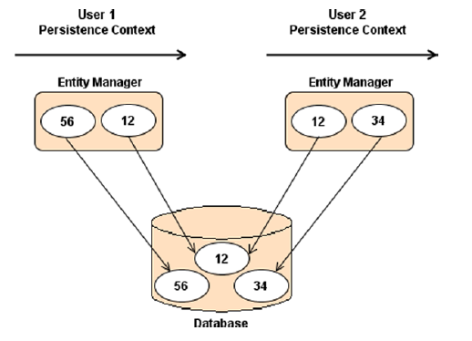
Persistence Unit, Persistence Context and Entity Manager

Slide 52
persistence.xml
Defines one or more Persistence Units.
A Persistence Unit may define:
Transaction handling
Datasource / provider
Standard and vendor specific properties
javax.persistence.jdbc.driver
javax.persistence.jdbc.url
javax.persistence.jdbc.user
javax.persistence.jdbc.password

Slide 53
Entity Manager
Main interface for working with the database.
Used for all CRUD operations.
persist()
find()
merge()
remove()
Obtained from “the container”.
CRUD
Java Persistence Query Language (JPQL) / Hibernate Query Language (HQL)
Criteria API (OO queries)
Native SQL
Provides a first level cache

Slide 54
Queries
Named (static)
JPQL / HQL
Hybrid SQL / OO
Criteria API
OO
Native
SQL instead of JPQL / HQL
Stored procedures

Slide 55
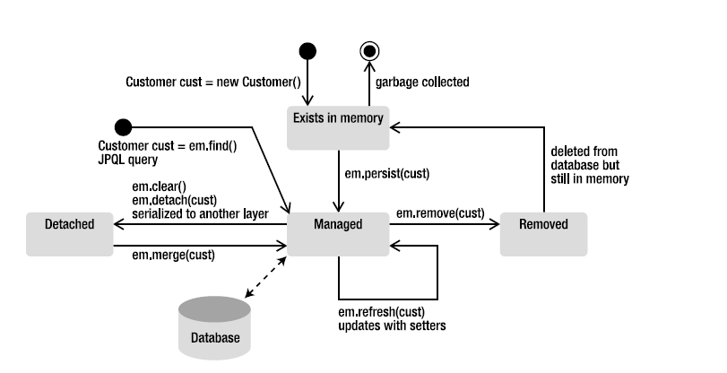
Entity Lifecycle

Slide 56

Your business logic
Enterprise Java Beans (EJB)

Slide 57
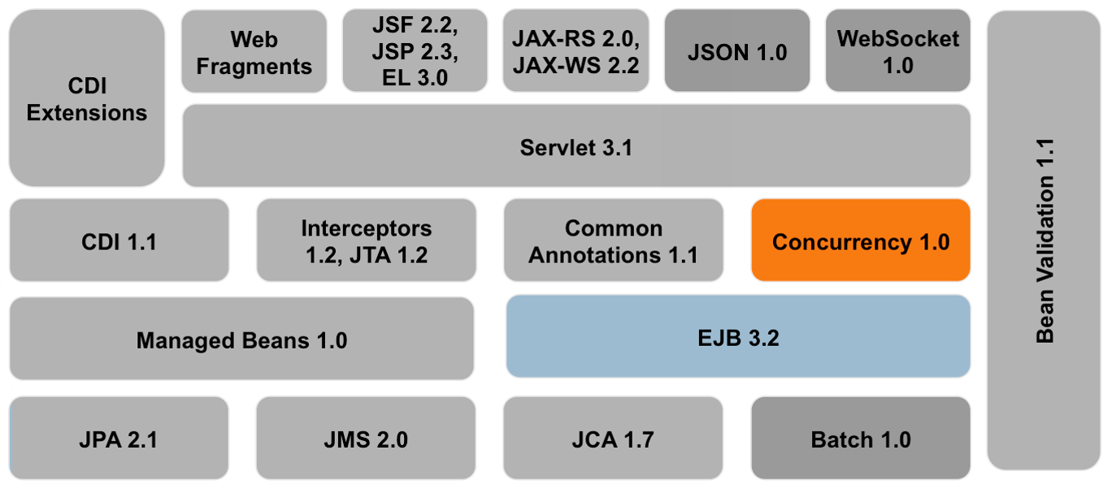
Enterprise Java Beans – Big Picture
Intro.

Slide 58
Enterprise Java Beans
Java Beans
Enterprise Java Beans
EJB Types
EJB Services
EJB Views
Concurrency
Lifecycle
Java Naming Directory Service
JNDI Naming

Slide 59

Java Beans ?
In computing based on the Java Platform, JavaBeans are classes that encapsulate many objects into a single object (the bean). They are serializable, have a zero-argument constructor, and allow access to properties using getter and setter methods.
JavaBeans - Wikipedia
https://en.wikipedia.org/wiki/JavaBeans

Slide 60

Java Bean == Component
Building block.
Easy defined and standarised interface.
Easy to work with. Nothing too tricky…

Slide 61

Enterprise Java Beans ?
EJBs are server-side components which encapsulate business logic.
EJB == Component++
A bean with all the trimmings expected in an “enterprise”.
Transactions
Concurrency
DI
State Management
Pooling
Lifecycle
Remote connections
Messaging
Security
AOP
JNDI

Slide 62

EJB Services
Let me repeat that….
DI
Lifecycle
Remote Communication
Pooling
AOP (Interceptors)
Concurrency
Tx
Security
Messaging
JNDI
Some overlap with CDI

Slide 63
EJB Bean Types
Session Beans
@Stateless
Can be used by any request.
Pooled.
@Stateful
Holds conversational state, involves passivation.
@Singleton
One per application instance.
Often used with @Startup
Message Driven Beans
@MessageDrivenBean
Used to implement Messaging (more later).
Entity Beans
Obsolete, use JPA instead.

Slide 64
EJB Views
Local (@Local)
EJB and client are within a single VM.
Method parameters are passed by reference from client to bean.
@Local public interface Foo {
//...
}
No-Interface (@LocalBean or just simply implementing no interface)
Very similar to Local.
Remote (@Remote)
EJB and client are used in a distributed environment (i.e. different VMs, across a network).
Method parameters are passed by value from client to bean (RMI and Serializable).

Slide 65
Local and Remote Views
@Local
public interface FooLocal { ... }
@Remote
public interface FooRemote { ... }
@Stateless
public class Foo implements FooLocal, FooRemote { ... }
public class FooClient {
@Inject private FooLocal localView;
@Inject private FooRemote remoteView;
@Inject private Foo noInterfaceView;
// ...
}

Slide 66
Local and Remote Views (don’t alter interface)
public interface FooLocal { ... }
public interface FooRemote { ... }
@Stateless
@Local(FooLocal.class)
@Remote(FooRemote.class)
public class Foo implements FooLocal, FooRemote { ... }
public class FooClient {
@Inject private FooLocal localView;
@Inject private FooRemote remoteView;
@Inject private Foo noInterfaceView;
// ...
}

Slide 67
Remote and No-Interface Views
@Remote
public interface FooRemote {
//...
}
@Stateless
@LocalBean
public class Foo implements FooRemote {
//...
}
public class FooClient {
@Inject private FooRemote remoteView;
@Inject private Foo noInterfaceView;
// ...
}

Slide 68
Concurrency
Threading with the container is handled by the container.
EJB spec forbids the manual creation of threads.
Thread creation should be done via the @Asynchronous annotation.
Container will handle the thread pool and lock management.
@Stateless
public class ABC {
// process the long running task in a separate thread
@Asynchronous
public void someLongRunningTask() { ... }
}

Slide 69
Concurrency
Any resource shared between threads is by guarded by default.
Can use JavaSE concurrency primitives for better granularity.
@Singleton
public class SharedResource {
@Lock(LockType.WRITE) // the default
public void someMethodA() { ... }
@Lock(LockType.READ)
public void someMethodB() { ... }
@Lock(LockType.READ)
public void somemethodC() {
synchronize(aLock) { ... }
}
}

Slide 70
Lifecycle (Stateless EJB)
public class ABC {
// no state here
public ABC() { // ctor }
@PostConstruct
public void init() { // ... }
@PreDestroy
public void cleanup() { // ... }
}

Slide 71

Java Naming and Directory Interface (JNDI)
Java API for a directory service that allows Java software clients to discover and look up data and objects via a name/reference.
An abstraction above other directpory services or directory service protocols
DNS, Active Directory, Novell eDirectory (NDS), LDAP, CORBA
JavaEE application servers typically host a JNDI provider internally.
EJBs are assigned names and registered with JNDI.
Pre DI, JNDI lookup was the old fashioned way of loose coupling.
Not quite IoC.
Still useful for remote access.
RMI across JVMs
JMS binding.

Slide 72
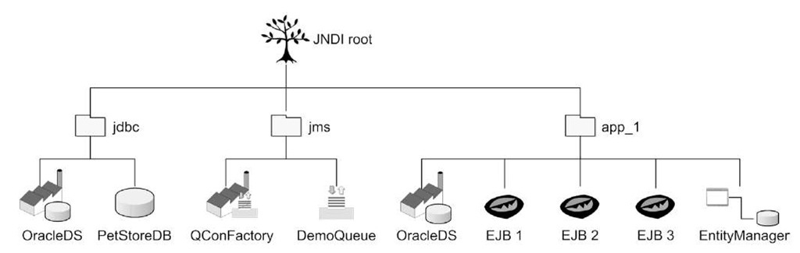
Java Naming and Directory Interface (JNDI)
JNDI is a component registry.

Slide 73
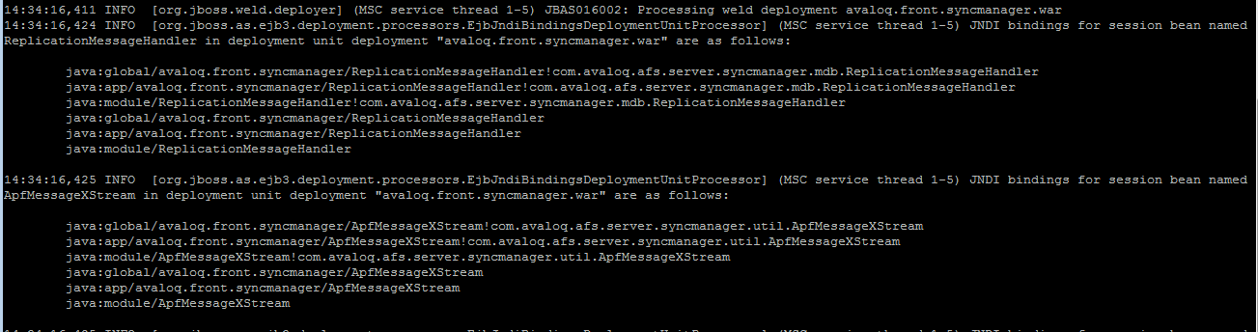
JNDI Naming
Each EJB will be assigned multiple binding across the namespaces…
java:global, java:module, java:app, java:comp
… according to how they are deployed – EAR, WAR or JAR.
JavaEE application servers may provide their own namespaces
jboss:
According to how they are deployed – EAR, WAR or JAR.
Only of real relevance for JNDI lookup (@Resource)

Slide 74
Invoking EJB from Client
Via CDI injection
@Inject private FooLocal localView;
Via EJB injection
@EJB private FooLocal localView;
Via JNDI
Used when client is not a Managed Bean (i.e. not in a container)
Conext ctx = getContext();
FooRemote remoteView = (FooRemote) ctx.lookup(“java:global/foobar/Foo!com.avaloq.meh.FooRemote);

Slide 75
Reliable messaging
Java Messaging Service (JMS)

Slide 76
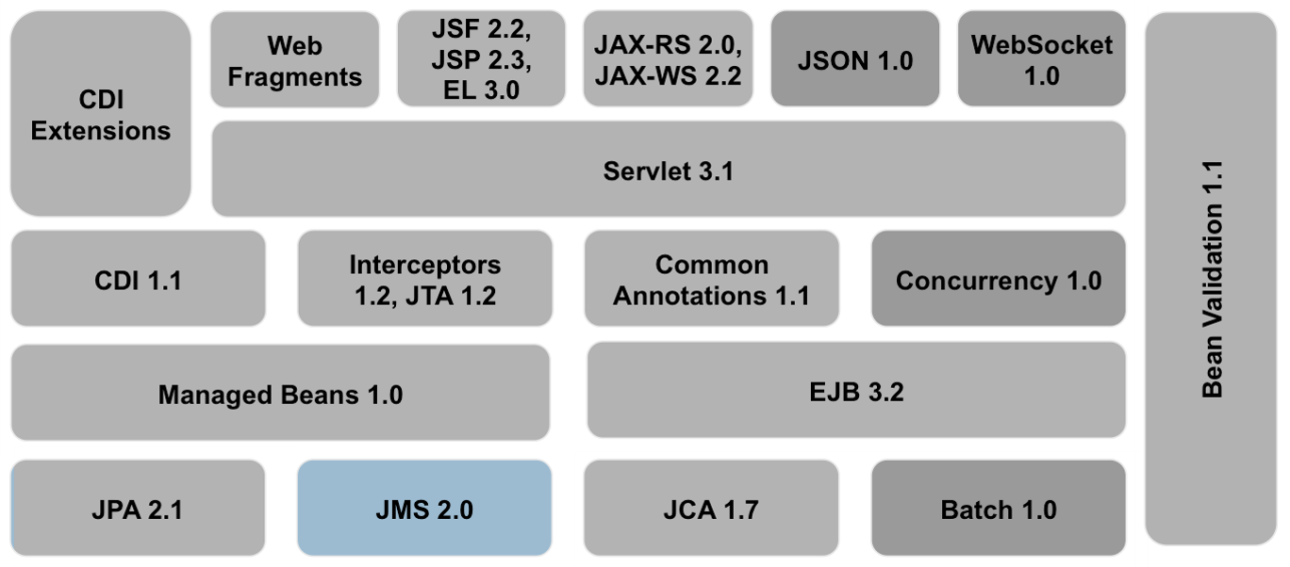
Java Messaging Service - Big Picture
Intro.

Slide 77
Java Messaging Service
Messaging
Java Message Service
JMS Destinations – Queues and Topics
Message Drive Beans
Administered Objects
JMS Client

Slide 78
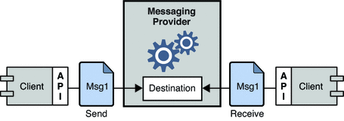
Messaging
Message Oriented Middleware (MOM) is an infrastructure component supporting communication between distributes systems via the sending and receiving of messages.
MOM creates a distributed communications layer that insulates the application developer from the details of the various operating systems and network interfaces.
Provides loose coupling.

Slide 79
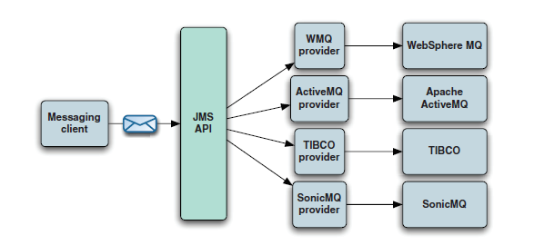
Java Messaging Service (JMS)
JMS is a Java API that allows applications to create, send, receive, and read messages.
AFP reference implementation = Apache ActiveMQ.

Slide 80
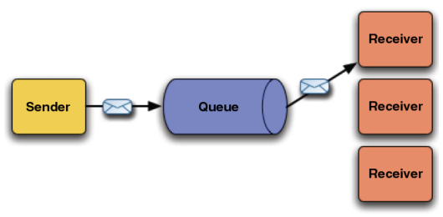
JMS Destinations – Queues and Topics
Queues - for point to point messaging.
Messages are consumed by a single receiver.

Slide 81
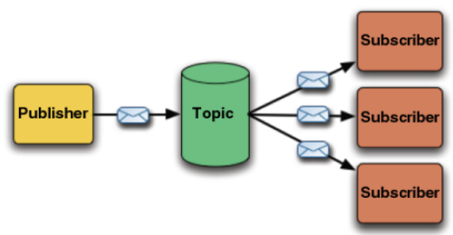
JMS Destinations – Queues and Topics
Topics - for publish/subscribe messaging.
Messages are may be consumed by a multiple receivers.

Slide 82
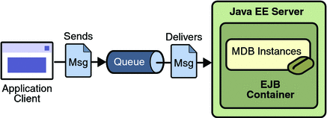
Message Driven Beans (MDB)
A Message Driven Bean is a stateless, server-side, transaction-aware component that is driven by a Java message ( javax.jms.message ).
It is invoked by the EJB Container when a message is received from a JMS Queue or Topic. It acts as a simple message listener.
MDB are EJB.

Slide 83
MDB
@MessageDriven(
activationConfig = {
@ActivationConfigProperty(
propertyName = "destination",
propertyValue = "java:/jms/queue/SomeQueue")
})
public class SomeMDB implements MessageListener {
public void onMessage(Message message) {
try {
System.out.println("Received message" + message);
} catch (JMSException e) {
//...
}
}
}

Slide 84
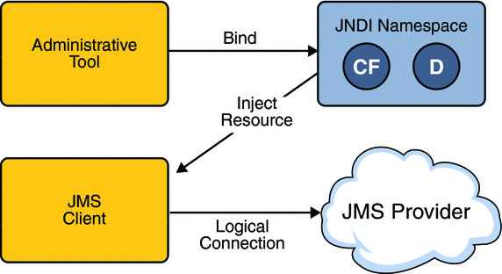
Administered Objects
In addition to server and client code, the container needs to be aware of Administered Objects - objects containing configuration information that are created by an administrator and later used by JMS clients.
Typically configured objects in a JNDI namespace, clients then access via Resource Injection.

Slide 85
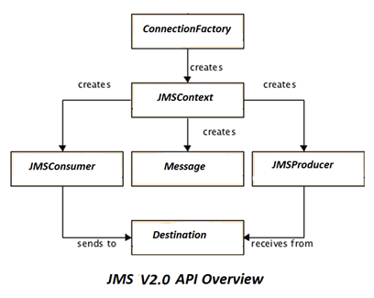
Simplified (v2) API

Slide 86
JMS Client
// Lookup the admin objects from JNDI space
ConnectionFactory connectionFactory = (ConnectionFactory) jndiContext.lookup("jms/RemoteConnectionFactory");
Destination queue = (Destination) jndiContext.lookup("jms/javaee-concepts/queue/BookOrderQueue");
// create the JMS Context
try (JMSContext context = connectionFactory.createContext("user", “password")) {
// send an object message to the queue
JMSProducer producer = context.createProducer();
producer.send(queue, msgBody);
}

Slide 87

Interfacing
Web Services - SOAP

Slide 88
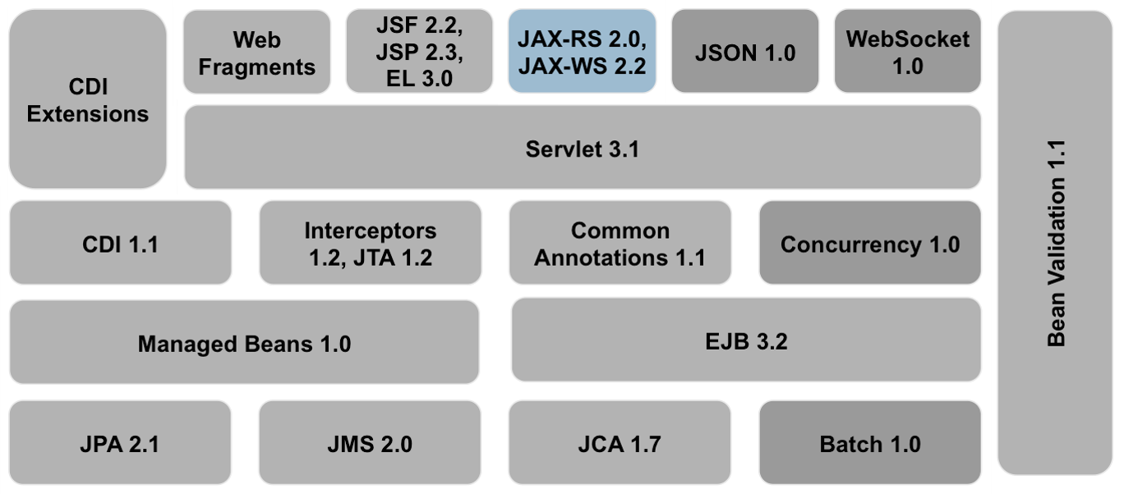
Web Services – Big Picture
Intro.

Slide 89
Web Services
Web Services
Simple Object Access Protocol
Web Service Definition Language
JAX-WS
JBoss and Apache CXF
JBoss and Web Services
UDDI

Slide 90
Web Services
A standardized way of integrating Web-based applications using the XML, SOAP, and WSDL over an Internet protocol backbone.
XML is the data format used to contain the data and provide metadata around it.
SOAP is used to transfer the data.
WSDL is used for describing the services.

Slide 91
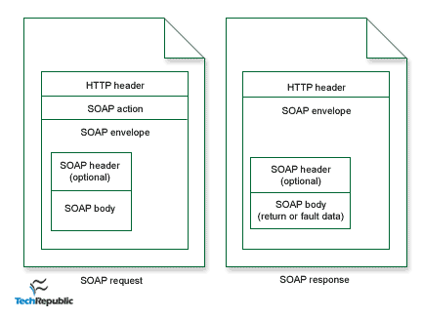
Simple Object Access Protocol - SOAP
A messaging protocol that allows programs that run on disparate operating systems (such as Windows and Linux) to communicate using Hypertext Transfer Protocol (HTTP) and its Extensible Markup Language (XML).

Slide 92
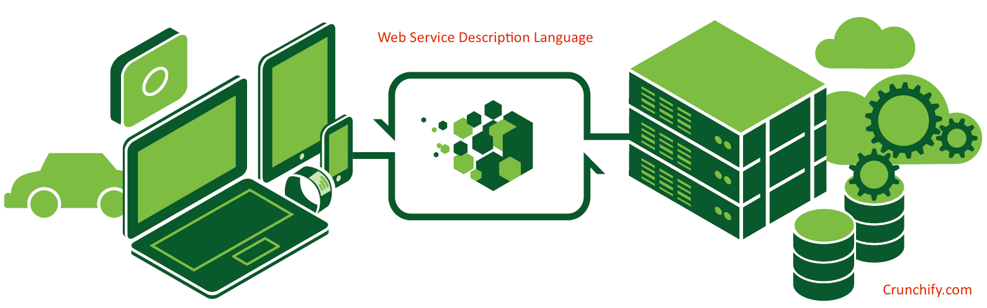
Web Service Definition Language – WSDL
An XML format for describing network services as a set of endpoints operating on messages containing either document-oriented or procedure-oriented information.
Forms a contract between the consumer and the service.

Slide 93
Contract First and Contract Last
WSDL = the Web Service Contract
Top down / Contract First.
Start with the WSDL and generate the code for the service and consumer from that.
wsimport
Bottom up / Contract Last
Start with the service implementation, generate the WSDL from the code.
wsgen
Contract First (CF) vs Contract Last (CL)
CL is fragile.
CL is less performant (XML and objects are somewhat opaque).
CF is reusable (complex objects).
CF has looser coupling between API and implementation.
CF preferable.

Slide 94
JAX-WS and Creating a Web Service
The Java API for XML Web Services (JAX-WS) is the component of JavaEE for creating SOAP Web Services.
JAX-WS supports the bottom-up approach, annotating the service implementation to identify it to be exposed as a Web Service.
@WebService
public class CardValidator {
@WebMethod
public boolean validate(CreditCard creditCard) {
return isEven(creditCard.getLastNumber());
}
}

Slide 95
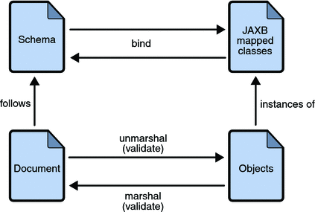
WebServcies and JAXB
Java Architecture for XML Binding (JAXB) is a software framework that allows Java developers to map Java classes to XML representations.
JAXB provides two main features: the ability to marshal Java objects into XML and the inverse, i.e. to unmarshal XML back into Java objects.

Slide 96

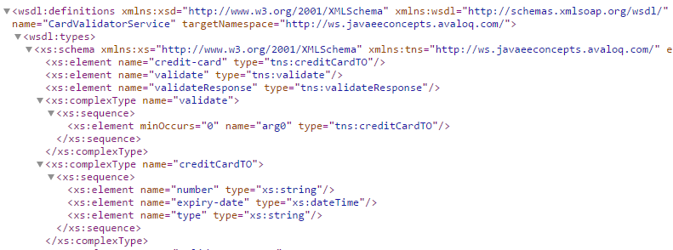
JBoss and Apache CXF
JBoss uses Apache CXF for it’s WebService implementation.
http://localhost:8080/ws/CardValidator?wsdl

Slide 97

JBoss and WebServcies
JBoss lists the Web Service endpoints via the UI.

Slide 98

Universal Description, Discovery and Integration (UDDI)
UDDI is an registry for business web services.
It used to be one of the trio of Web Services technologies
SOAP, WSDL and UDDI
Not as widely adopted as the designers hoped.
Occasionally found within the enterprise.
Pining for the fjords.

Slide 99

Interfacing
REST

Slide 100
REST – Big Picture
Intro.

Slide 101
Representational State Transfer - REST
REST stands for Representational State Transfer. (It is sometimes spelled "ReST".) It relies on a stateless, client-server, cacheable communications protocol -- and in virtually all cases, the HTTP protocol is used.
An architecture style, first introduced in 2000.
Hugely successful, in 2010 account for 74% of public network APIs.
Maps nicely to CRUD.
JAX-RS.

Slide 102
REST – Resources
A “resource-orientated API” is modeled as a resource hierarchy.
Resources
Anything a client may need to interact with (an entity).
Either a simple resource or a collection resource.
Resource Names
Identifiers for entities.
Each resource must have it’s own unique resource name.
Made up of the ID of the resource, the ID of any parent resource and the API service name.
API Service Name | Collection ID | Resource ID | Collection ID | Resource ID
//foobar.com | /books | /123 | /authors | /name@example.com

Slide 103
REST – Resources
Full Resource Name
A scheme-less URI uniquely identifying a hierarchical resource.
//foobar.com/books/123/authors/bob@example.com
Resource Name vs URL
Resource Names resemble normal URLs, but they’re not the same thing.
A single resource can be exposed by different API versions and protocols.
To use a full resource name via REST, it must be conveyed to a URL.
https://foobar.com/books/123/authors/bob@example.com

Slide 104
REST – HTTP Methods and Response Codes
HTTP Methods
GET
POST
PUT
DELETE
TRACE, OPTIONS, CONNECT, PATCH
HTTP Response Codes
1xx Informational
2xx Success
200 – OK
201 - Created
3xx Redirection
4xx Client Error
403 - Forbidden
5xx Server Error
500 – Internal Server Error

Slide 105
REST – Resources and HTTP Methods and CRUD
Method | HTTP Verb Mapping | HTTP Request Body | HTTP Response Body | HTTP Response Code
List | GET <collection URL> | Empty | Resource list | 200 (OK)
Get | GET <resource URL> | Empty | Resource | 200 (OK)
Create | POST <collection URL> | Resource | Resource | 201 (Created)
Update | PUT <resource URL> | Resource | Resource | 200 (OK)
Delete | DELETE <resource URL> | Empty | Empty | 204 (No Content)

Slide 106
REST – Representation
Client expects responses to be in a defined representation.
Client may also send data in a defined representation.
JSON / XML.
HTTP Header Content-Type / Accept
Content-Type – representation the client is sending.
Accept – representation the client accepts for the response.

Slide 107
REST – Create a Book
Request | Response
POST /rest/books HTTP/1.1 Host: foobar.com Content-Type: application/json Accept: application/xml { "title": “Moby Dick", "price": 9.99, "description": “The tale of the white whale", "author": { "name" : “Herman Melville" } } | Connection: keep-alive Date: Wed, 12 Apr 2017 13:59:00 GMT Content-Type: application/xml <?xml version="1.0" encoding="UTF-8"?> <book id="3"> <title>Moby Dick</title> <price>9.99</price> <description>The tale of the white whale</description> <author id="4"> <name>Herman Melville</name> </author> </book>
POST /rest/books HTTP/1.1
Host: foobar.com
Content-Type: application/json
Accept: application/json {
"title": “Moby Dick",
"price": 9.99,
"description": “The tale of the white whale",
"author": {
"name" : “Herman Melville"
}
}

Slide 108

RESTEasy
RESTEasy is a Jboss project providing various frameworks to help you build RESTful Web Services and RESTful Java applications.
Implementation of the JAX-RS specification.
Tight integration with JBoss Application Server.

Slide 109
REST – Resources and HTTP Verbs
@RequestScoped @Path("/books") @Produces("application/json") @Consumes("application/json") public class BookController { @Inject private BookDAO bookDao; @POST public Book create(Book book) { return bookDao.createBook(book); } @GET public List<Book> findAll() { return bookDao.findAllBooks(); } @GET @Path("/{id}") public Book find(@PathParam("id") Long id) { return bookDao.findBookById(id); } @PUT public Book update(Book book) { return bookDao.updateBook(book); } @DELETE public void remove(@QueryParam("id") Long id) { bookDao.deleteBook(id); } }

Slide 110
JAX-RS - Params
Params, either as part of the URL path or a query on the URL (amongst others).
@Path("/{id}") Book find(@PathParam("id") Long id);
Part of URL (@PathParam)
/books/123
void remove(@QueryParam("id") Long id);
Query on the URL (@QueryParam)
/books?id=123
@Bean Param
Used to aggregate parameters.
JAX-RS will introspect and inject parameters.

Slide 111


Postman
Client tool for REST APIs
REST HTTP verbs

Slide 112


REST vs SOAP
REST is leaner and hence more performant
Any downsides?

Slide 113

Deployment…
Packaging

Slide 114
Packaging
To deploy into a container (app server) the binaries and associated resources need to be packaged in a standard archive (the package).
Packages are likely to contain
Java classes
Resources / meta-info (config, images, properties etc…)
Deployment descriptors (both standard and proprietary).
Standard formats, based on ZIP file type..
JAR (Java Archive)
WAR (Web Archive)
EAR (Enterprise Archive)

Slide 115
Common Packages and Deployment Descriptors
JAR (JavaSE)
Part of the JavaSE environment.
META-INF/MANIFEST.MF which specifies meta info on the package.
JAR (JavaEE)
Deployed in an EJB container.
An EJB module containing Session beans or MDBs packaged in an EJB JAR.
META-INF/ejb-jar.xml
WAR
Web modules containing Servlets, JSPs, JSF pages etc…
WEB-INF/web.xml
EAR
Enterprise modules which can contain WAR and JARs
META-INF/application.xml.
lib/ director can be used for common dependencies.

Slide 116
Deployment Descriptors
Descriptor | Location | Spec | Description
application.xml | META-INF of EAR | JavaEE
web.xml | WEB-INF | Servlet
beans.xml | WEB-INF or META-INF | CDI | Actives CDI
persistence.xml | META-INF | JPA | Describes persistence units
jboss-deployment-structure.xml | WEB-INF or META-INF |  | Used to control class loading for the deployment
jboss-web.xml | WEB-INF |  | Override web.xml and provide JBoss specific options.

Slide 117

Your journey has just begun…
Find it in the your nearest library

Slide 118

The Future ?

Slide 119
Thank you for your attention.
Simon Nattrass
Simon.Nattrass@avaloq.com

Slide 120


But…

Slide 121
Top Down (WSDL to Client Implementation)
The wsimport tool is used to parse an existing Web Services Description Language (WSDL) file and generate required files (JAX-WS portable artifacts) for web service client to access the published web services
WSDL -> Java skeleton code for client.

